Slide 1
Phylum Echinodermata:
echinos = spiny derma = skin ata = to bear
MOGAJI, H.O.
Department of Animal and Environmental Biology
Federal University Oye-Ekiti

Slide 2
GENERAL CHARACTERISTICS
They are unsegmented
Coelemate animals
Bilaterally symmetrical in the larval stage.
Pentaradially symmetrical in the adult
They possess a DERMAL SKELETON which consists of calcareous ossicles

Slide 3
GENERAL CHARACTERISTICS
These bones may develop short or long spines.
The nervous system is diffuse and remains attached to the epidermis.
No nephridia or any other special excretory organs.
The sexes are separate and gonads discharge by special ducts directly to the exterior.

Slide 4
GENERAL CHARACTERISTICS
The echinoderms are very common as fossil forms (since the Cambrian period) and are entirely marine.
Water-vascular system used in locomotion, attachment, &/or feeding.
None of them are parasitic
.

Slide 5
Niche:
- relatively slow moving
- feeding
  *some species feed on animal remains on the ocean floor
  *some filter plankton through their mouth pore
  *some scrape food off rocks
  *others are predaceous on mollusks, arthropods
Habitat:
- marine environments
- bottom of deep seas
-bottom of coastal shores

Slide 6
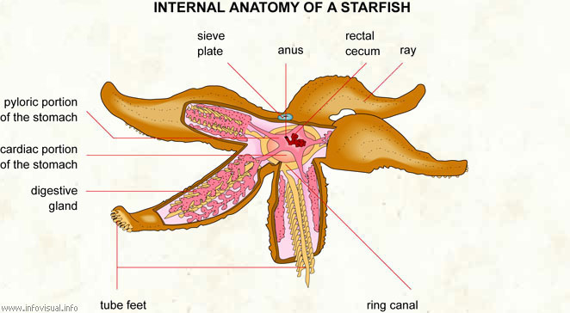
Digestive System:
-have an anus, but it is almost nonfunctional; undigested food is expelled back through the mouth
-respond to light, chemicals, and various mechanical stimuli

Slide 7
Reproduction:
dioecious – the two sexes are indistinguishable externally
gamete release by one individual is accomplished by the release of spawning pheromones, which induce other sea stars in the area to spawn, increasing the likelihood of fertilization

Slide 8
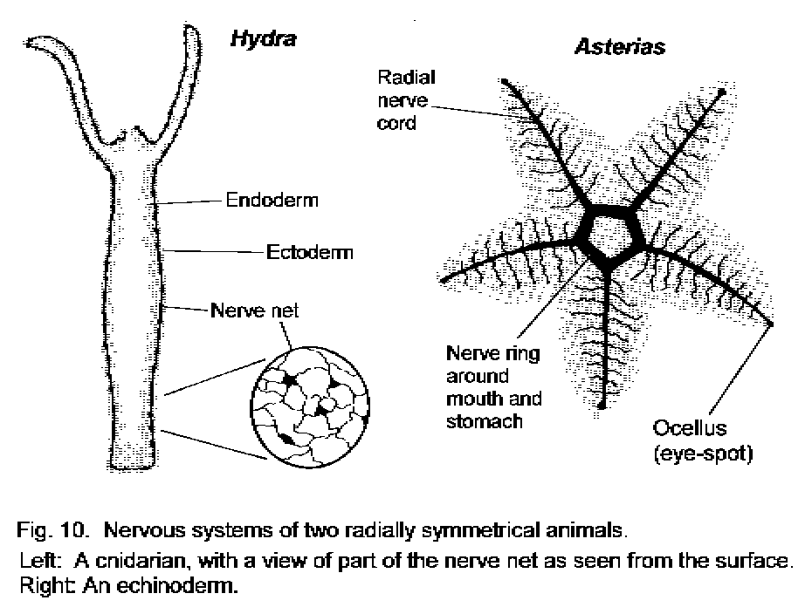
Nervous System:
o nerve ring that encircles the mouth
o radial nerves that extend into each arm (these coordinate the functions of the tube feet)
other nervous elements are in the form of a nerve net associated with the body wall

Slide 9
The phylum Echinodermata is classified into two sub‐phyla:
    Subphylum I Eleutherozoa
    Subphylum II Pelmatozoa

Slide 10
Subphylum Eleutheroza
The Subphylums Eleutheroza are free living forms, without a stalk.
They have 4 living classes
  Class I Asteroidea e.g. Starfishes
  Class II Ophiuroidea e.g. Bristle Stars
  Class III Echinoidea e.g. Sea urchins
  Class IV Holothuroidea e.g. Sea cucumbers

Slide 11

Class Asteroidea examples: sea stars (starfish)
sea stars:
1. most common echinoderm; central disc and 5 arms (or rays) radiating from disc
2. may be various colors of red, purple, green, blue and yellow
3. range in size from about 2 cm to nearly a meter
4. found on pier pilings and rocks in tide pools along coasts

Slide 12

Class Ophiuroidea examples: brittle stars
brittle stars:
1. a distinct disc set apart from the arms
2. slender, articulating arms
3. rapid, serpentine (snakelike) movements
4. found on the seashore, burrowed in sand or deep sea sediments or under rocks and kelp

Slide 13
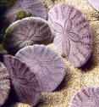
Class Echinoidea examples: sand dollars, sea urchins
sand dollars
1. range in size from 1-15 cm
2. flattened skeleton (test) covered with a dense thicket of tiny spines
3. aboral surface exhibits flower petal-shaped grooves petaloids) that correspond to the arms of sea stars and brittle stars
4. tube feet in the petaloids are used in locomotion

Slide 14
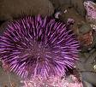
Class Echinoidea examples: sand dollars, sea urchins
sea urchins
1. rounded body shape
2. long spines on exterior
3. the areas corresponding to the rays of the sea stars are fused

Slide 15
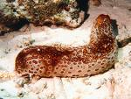
Class Holothruoidea examples: sea cucumbers, feather stars
sea cucumbers
1. long, cucumberlike body lacking a solid, calcareous skeleton
2. oral end has a ring of retractile tentacles that represent highly modified tube feet
3. found on the sea bottom, often partially submerged in mud or sand, or among intertidal rocks

Slide 16

Class Holothruoidea examples: sea cucumbers, feather stars
feather stars
1. most primitive of the living echinoderms
2. from a small cup or calyx, protrudes five flexable arms (rays) with branches (pinnules) very much like pine needles

Slide 17
Subphylum Pelmatozoa
The subphylum Pelmatozoa are sessile forms, usually stalked,
Represented among the living echinoderms by the class Crinoidea e.g. Sea lilies and Sea feathers.

Slide 18
Class Crinoidea
Most primitive of the echinoderms.
Unusual in that the oral surface is directed upward
Aboral surface is attached to the substrate by means of a bendable stalk
The portion of the crinoid body attached to the stalk is called the crown; bears a number of arms

Slide 19
Along the length of the arms are branches called pinnules
The arms and the pinnules have ambulacral grooves with suckerless podia (secrete mucus)
The ambulacral grooves are heavily ciliated and the cilia is used to direct food to the mouth (=filter feeding)

Slide 20
